Slide 1

Digital Champions in Adult Social Care
Session 09 April 2025

Slide 2
Welcome back!
Use the chat to drop an emoji, showing us how you feel (hint press the Windows key and “.” to show the emoji keyboard
Why did the computer go to the doctor? Because it had a virus! 🖥️😷

Slide 3
Agenda
Skills for care training
Using Technology to Support Person-Centred Care
Technical Skills in using technology
One more topic – confirmed on 4/4 (the state of cyber security?)
Ministerial foreword and report summary - GOV.UK

Slide 4
Resources
Click on image to access file
Document your progress
DoubleClick Image

Slide 5
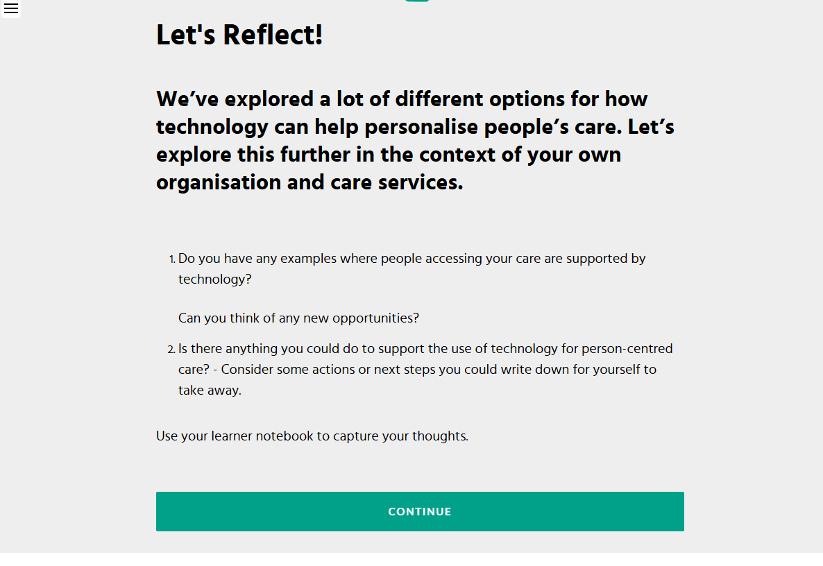
Reflection – TEC to support person centered care
Please use the chat, or your microphone and camera to share your thoughts.

Slide 6
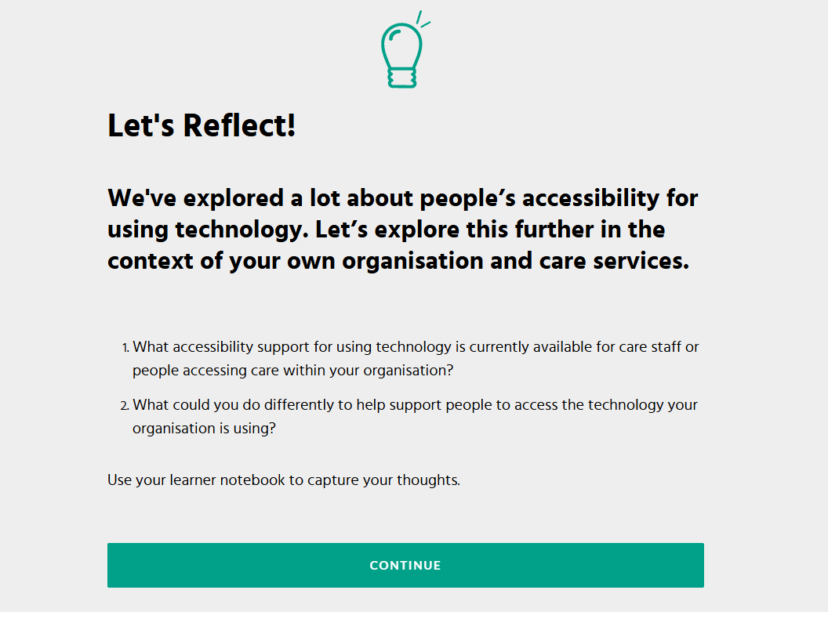
Reflection – Technical skills in using technology
Please use the chat, or your microphone and camera to share your thoughts.

Slide 7
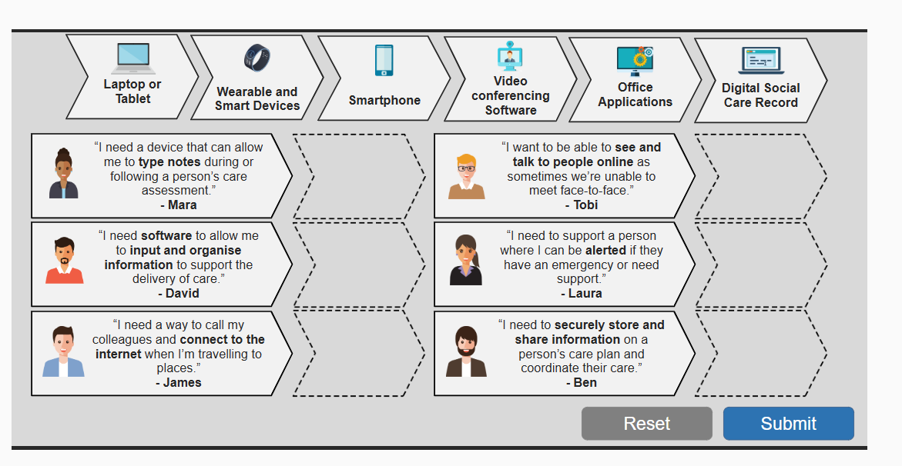
Quiz 1

Slide 8
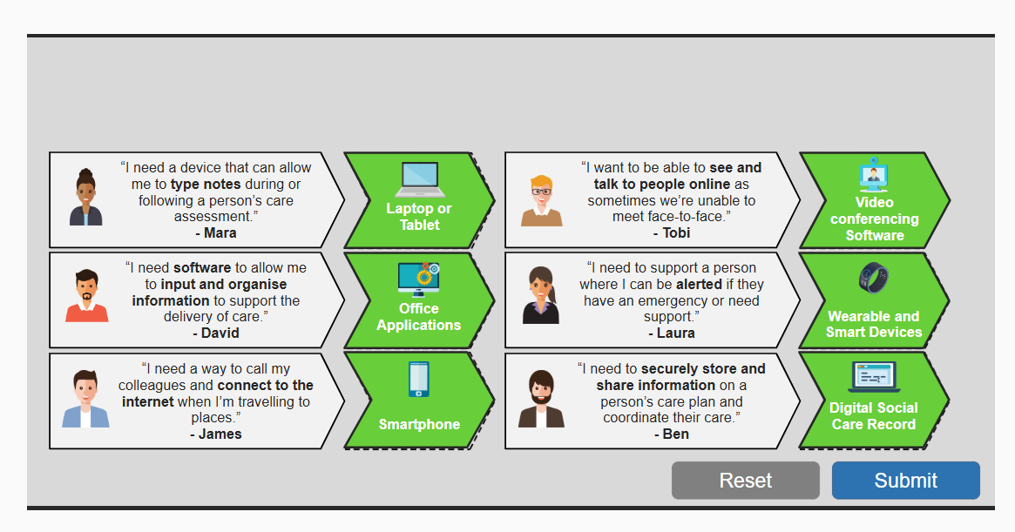
Quiz 1 - Answer

Slide 9
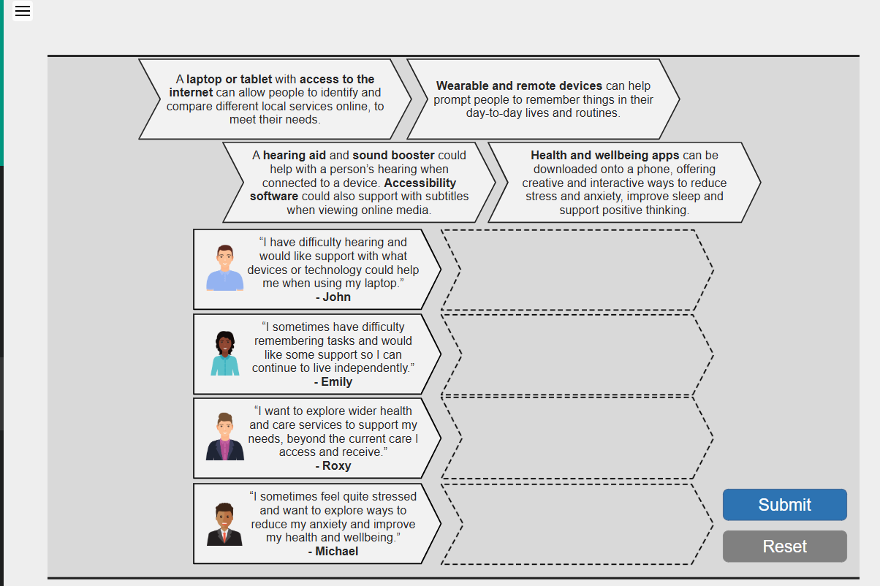
Quiz 2

Slide 10
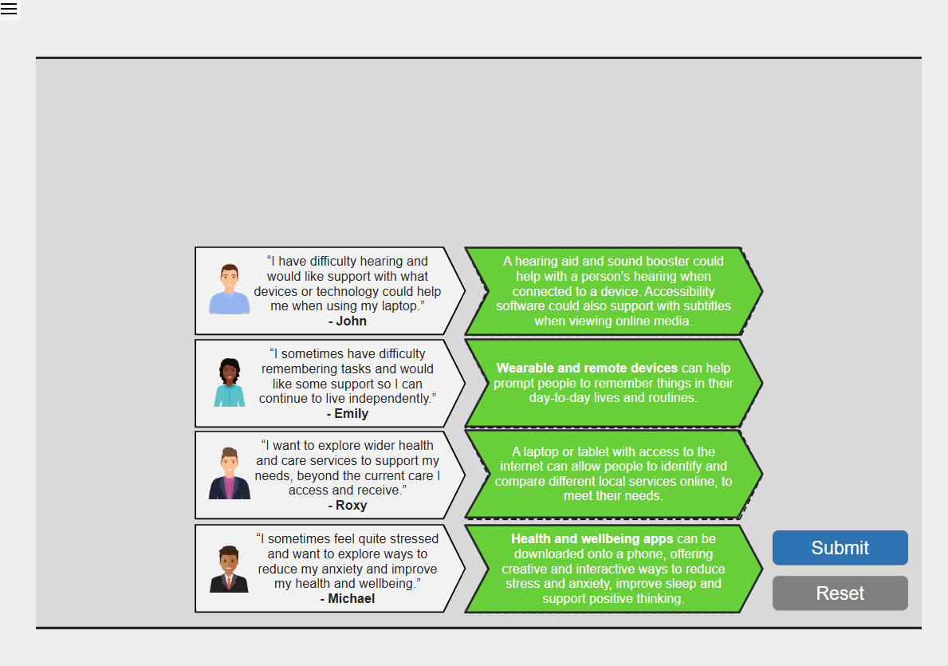
Quiz 2 - Answer

Slide 11
Cyber Security – Top Risks
Ministerial foreword and report summary - GOV.UK
Phishing and Ransomware Attacks - often targeting staff through deceptive emails or messages.
Low Cyber Maturity and Digital Skills Gaps- Frontline staff often lack training, partly due to high turnover and inconsistent digital skills development.
Risky Day-to-Day Practices – Poor password practice/use over multiple accounts. Use of shared or personal devices is widespread, increasing the risk of data leakage or malware infections.

Slide 12
How can a Digital Champion support?
Raise Awareness and Promote a Cyber-Safe Culture
Share knowledge about common threats (e.g. phishing, weak passwords)
Encourage conversations about cyber security in team meetings
Train and Support Colleagues
Help frontline staff recognise phishing emails and suspicious links
Provide hands-on help with secure behaviours
Organise or signpost to training sessions on cyber security

Slide 13
How can a Digital Champion support?
Data Security And Protection In Social Care Course
Relevant to all staff
Data Security and Protection eLearning - Leads - Digital Care Hub
Relevant to people with responsibility for data and cyber security
Both training options include training on Data Protection Rights & Responsibilities, Keeping Data Secure, Threats to Data Security & Data Breaches

Slide 14
Most commonly used passwords
123456 123456789 Qwerty Password 1234567 12345678 12345 Iloveyou 111111 123123 | Abc123 Qwerty123 1q2w3e4r Admin Qwertyuiop 654321 555555 Lovely 7777777 welcome

Slide 15
How can a Digital Champion support?
Make sure passwords are ‘switched on’
Don’t force regular password changes
Use multi-factor authentication if possible
Make sure all ‘default’ passwords are changed, including on your Wi-fi router
Train staff - commonly used passwords, recycling passwords across home and work accounts, avoiding personal information (such as names, dates, and sports teams)
Use three random words to help create less predictable passwords

